Slide 1
Greedy Algorithms

Slide 2
Optimization problems
An optimization problem is one in which you want to find, not just a solution, but the best solution
A “greedy algorithm” sometimes works well for optimization problems
Problems exhibit optimal substructure (like Dynamic programming).
Problems also exhibit the greedy-choice property:
You take the best you can get right now, without regard for future consequences
You hope that by choosing a local optimum at each step, you will end up at a global optimum
Notes:
2

Slide 3
Example: Counting money
Suppose you want to count out a certain amount of money, using the fewest possible bills and coins
A greedy algorithm would do this would be: At each step, take the largest possible bill or coin that does not overshoot
Example: To make 6723 tenge, you can choose:
a 5000 bill
a 1000 bill, to make 6000
a 500 bill, to make 6500
a 200 bill, to make 6700
and 20 coin, 2 coin, 1 coin to make 6723 tenge
For KZ money, the greedy algorithm always gives the optimum solution
Notes:
3

Slide 4
A failure of the greedy algorithm
In some (fictional) monetary system, “krons” come in 1 kron, 7 kron, and 10 kron coins
Using a greedy algorithm to count out 15 krons, you would get
A 10 kron piece
Five 1 kron pieces, for a total of 15 krons
This requires six coins
A better solution would be to use two 7 kron pieces and one 1 kron piece
This only requires three coins
The greedy algorithm results in a solution, but not in an optimal solution
Notes:
4

Slide 5
A scheduling problem
You have to run nine jobs, with running times of 3, 5, 6, 10, 11, 14, 15, 18, and 20 minutes
You have three processors on which you can run these jobs
You decide to do the longest-running jobs first, on whatever processor is available
P1
20
10
3
P2
18
11
6
P3
15
14
5
Time to completion: 18 + 11 + 6 = 35 minutes
This solution isn’t bad, but we might be able to do better
Notes:
5

Slide 6
Another approach
What would be the result if you ran the shortest job first?
Again, the running times are 3, 5, 6, 10, 11, 14, 15, 18, and 20 minutes
P1
3
10
15
P2
5
11
18
P3
6
14
20
That wasn’t such a good idea; time to completion is now 6 + 14 + 20 = 40 minutes
Note, however, that the greedy algorithm itself is fast
All we had to do at each stage was pick the minimum or maximum
Notes:
6

Slide 7
An optimum solution
Better solutions do exist:
P1
20
14
P2
18
11
5
P3
15
10
6
3
This solution is clearly optimal (why?)
Clearly, there are other optimal solutions (why?)
How do we find such a solution?
One way: Try all possible assignments of jobs to processors
Unfortunately, this approach can take exponential time
Notes:
7

Slide 8

Activity-selection Problem
Input: Set S of n activities, a₁, a₂, …, a_{n}.
s_{i} = start time of activity i.
f_{i} = finish time of activity i.
Output: Subset A of maximum number of compatible activities.
Two activities are compatible, if their intervals don’t overlap.
Example:
Activities in each line are compatible.

Slide 9
Optimal Substructure
Assume activities are sorted by finishing times.
f₁ ≤ f₂ ≤ … ≤ f_{n}.
Suppose an optimal solution includes activity a_{k}.
This generates two subproblems.
Selecting from a₁, …, a_{k-1}, activities compatible with one another, and that finish before a_{k} starts (compatible with a_{k}).
Selecting from a_{k+1}, …, a_{n}, activities compatible with one another, and that start after a_{k} finishes.
The solutions to the two subproblems must be optimal.

Slide 10
Recursive Solution
Let S_{ij} = subset of activities in S that start after a_{i} finishes and finish before a_{j} starts.
Subproblems: Selecting maximum number of mutually compatible activities from S_{ij}.
Let c[i, j] = size of maximum-size subset of mutually compatible activities in S_{ij}.

Slide 11
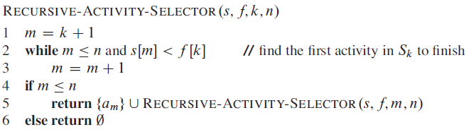
Recursive Algorithm
Initial Call: Recursive-Activity-Selector (s, f, 0, n+1)
Complexity: Θ(n)

Slide 12
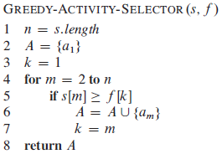
Iterative algorithm

Slide 13
Data compression
Suppose we have 1000000000 character data file that we wish to include in an email.
Suppose file only contains 26 letters {a,…,z}.
Suppose each letter α in {a,…,z} occurs with frequency f_{α}.
Suppose we encode each letter by a binary code.
If we use a fixed length code, we need 5 bits for each character
The resulting message length is

Slide 14
Huffman Codes
Developed by David A. Huffman, published in 1952.
Most character code systems (ASCII, unicode) use fixed length encoding
If frequency data is available and there is a wide variety of frequencies, variable length encoding can save 20% to 90% space
Which characters should we assign shorter codes; which characters will have longer codes?

Slide 15
Data Compression - example
Suppose the file only has 6 letters {a,b,c,d,e,f} with frequencies
Fixed length 3G=3000000000 bits
Variable length
Fixed length
Variable length
~25% savings

Slide 16
Data Compression - example
How to decode?
At first it is not obvious how decoding will happen, but this is possible if we use prefix codes

Slide 17
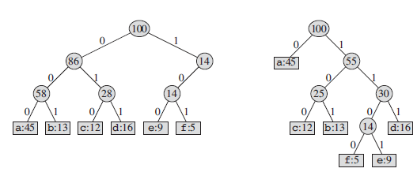
Prefix Codes
No encoding of a character can be a prefix of the longer encoding of another character.
For example, we could not encode t as 01 and x as 01101 since 01 is a prefix of 01101
By using a binary tree representation we will generate prefix codes provided all letters are leaves

Slide 18
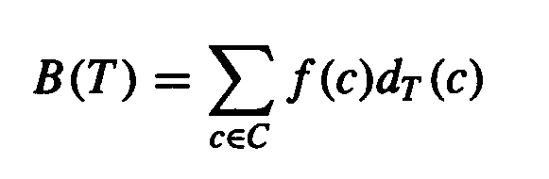
Some Properties
Prefix codes allow easy decoding
Given a: 0, b: 101, c: 100, d: 111, e: 1101, f: 1100
Decode 001011101 going left to right, 0|01011101, a|0|1011101, a|a|101|1101, a|a|b|1101, a|a|b|e
An optimal code must be a full binary tree (a tree where every internal node has two children)
For C characters – C leaves and there are C-1 internal nodes
Given a tree T corresponding to a prefix tree, the number of bits to encode a file is
where f(c) is the frequency of c, d_{T}(c) is the tree depth of c, which corresponds to the code length of c

Slide 19
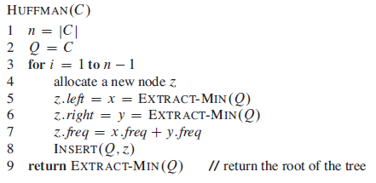
Huffman’s Algorithm
An appropriate data structure is a binary min-heap
Rebuilding the heap is lg n and n-1 extractions are made, so the complexity is O( n lg n )
The encoding is NOT unique, other encoding may work just as well, but none will work better

Slide 20



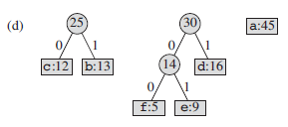
Building the Encoding Tree

Slide 21
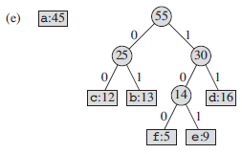
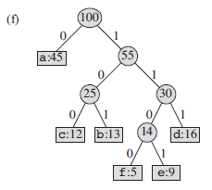
Building the Encoding Tree

Slide 22
Analysis
A greedy algorithm typically makes (approximately) n choices for a problem of size n
(The first or last choice may be forced)
Hence the expected running time is: O(n * O(choice(n))), where choice(n) is making a choice among n objects
Counting: Must find largest useable coin from among k sizes of coin (k is a constant), an O(k)=O(1) operation;
Therefore, coin counting is (n)
Huffman: Must sort n values before making n choices
Therefore, Huffman is O(n log n) + O(n) = O(n log n)
Notes:
11

Slide 23
Other Greedy Algorithms
Dijkstra’s algorithm for finding the shortest path in a graph
Always takes the shortest edge connecting a known node to an unknown node
Kruskal’s algorithm for finding a minimum-cost spanning tree
Always tries the lowest-cost remaining edge
Prim’s algorithm for finding a minimum-cost spanning tree
Always takes the lowest-cost edge between nodes in the spanning tree and nodes not yet in the spanning tree

